Slide 1

AI introduction part 2
Master. Cesar Sinchiguano
Robotics and Cybernetics

Slide 2

Today’s lecture
AI - Agents & Environments
The Functions of an Artificial Intelligence Agent
The Number and Types of Agents in Artificial Intelligence
The Structure of Agents in Artificial Intelligence
What Are Agents in Artificial Intelligence Composed Of?

Slide 3
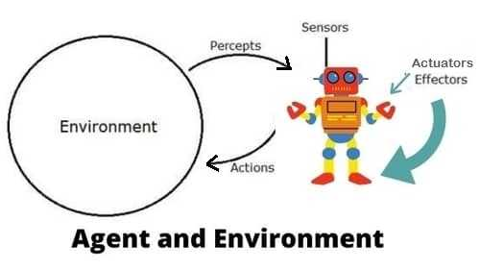
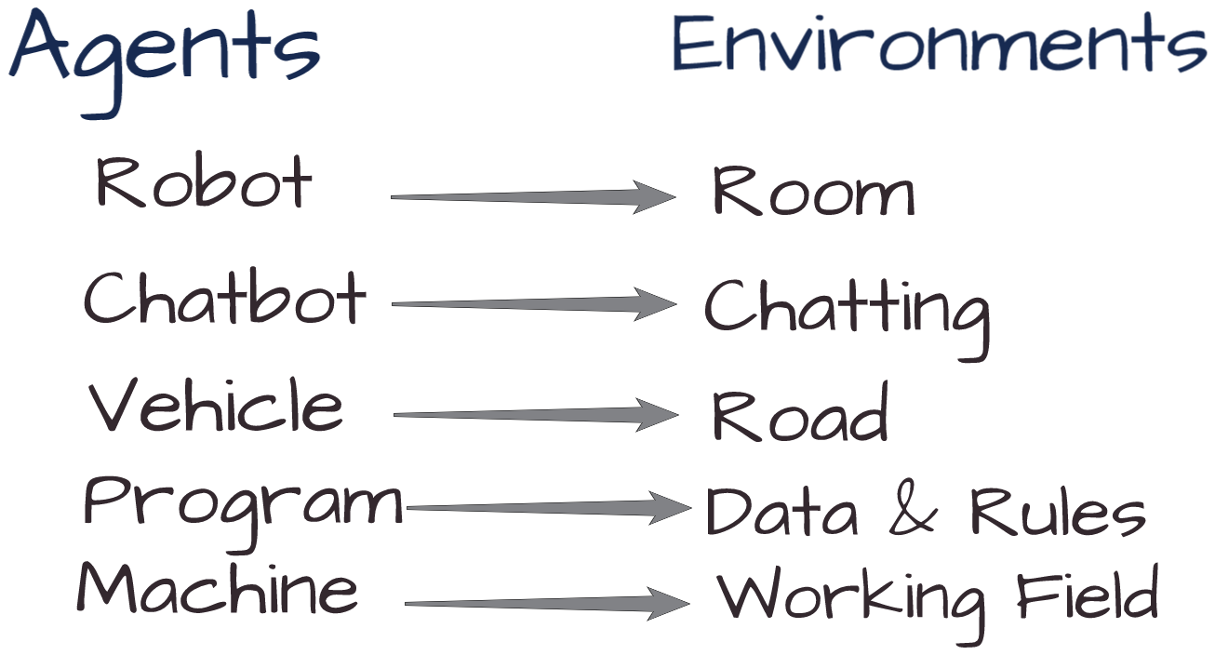
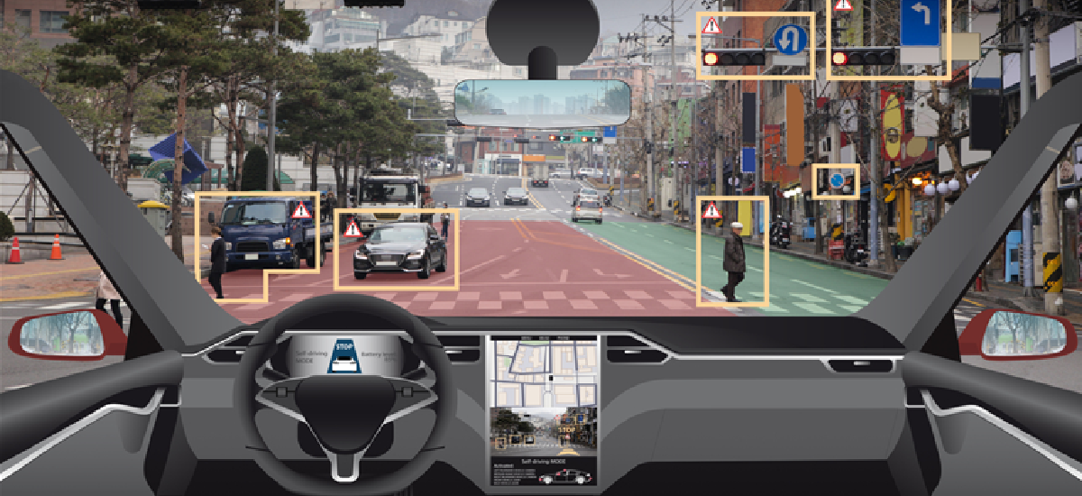
AI - Agents & Environments
An AI system is composed of an agent and its environment.
The agents act in their environment.
Agent is an independent program that interacts with its environment
by perceiving its surroundings via sensors, then acting through actuators.
Cognitive: relating to the processes of thinking and reasoning

Slide 4
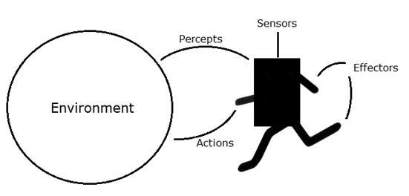
AI - Agents & Environments
An agent is anything that can perceive its environment through sensors and acts upon that environment through effectors.
A human agent has sensory organs such as eyes, ears, nose, tongue and skin to the sensors, and other organs such as hands, legs, mouth, for effectors.
A robotic agent replaces cameras and infrared range finders for the sensors, and various motors and actuators for effectors.
A software agent has encoded bit strings as its programs and actions.
Rationality: Rationality is nothing but status of being reasonable, sensible, and having good sense of judgment.

Slide 5

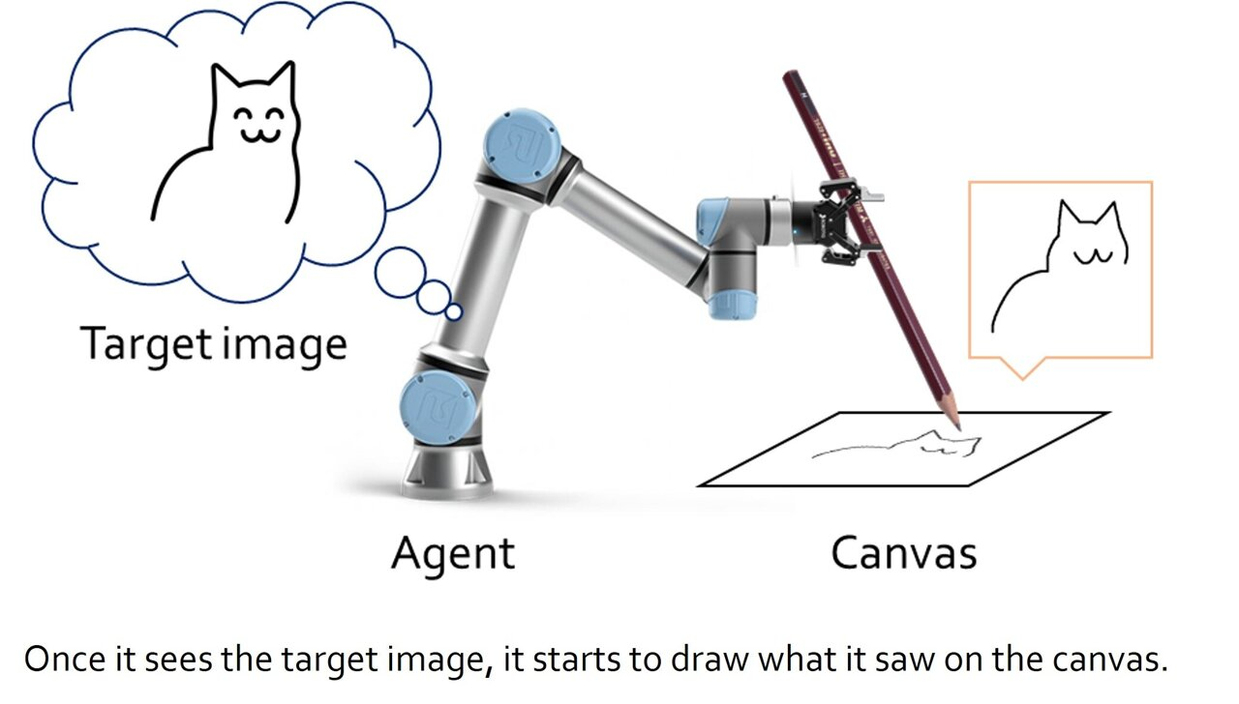
The Functions of an Artificial Intelligence Agent
AI agents perform these functions continuously:
Perceiving dynamic conditions in the environment
Acting to affect conditions in the environment
Using reasoning to interpret perceptions
Problem-solving
Determining actions and their outcomes
Perceive: to see something or someone

Slide 6
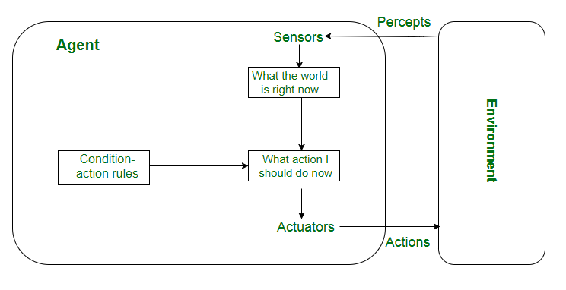
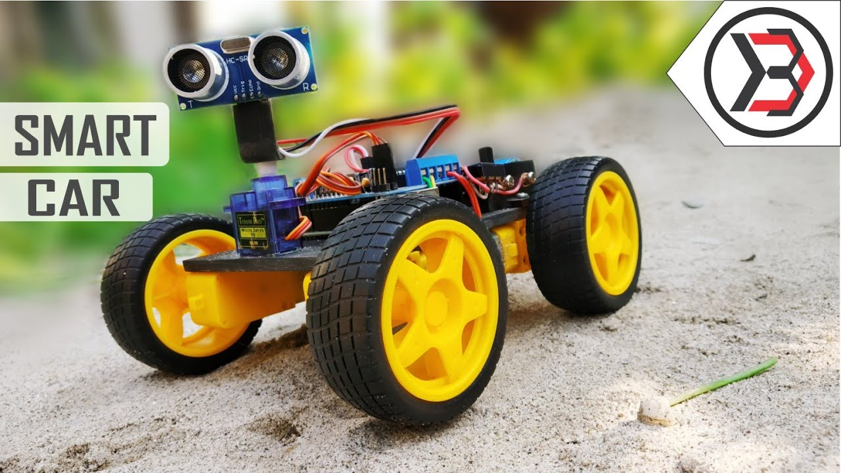
The Number and Types of Agents in Artificial Intelligence
There are five different types of intelligent agents used in AI. They are defined by their range of capabilities and intelligence level:
Reflex Agents:
These agents work here and now and ignore the past.
They respond using the event-condition-action rule.
The ECA rule applies when a user initiates an event, and the Agent turns to a list of pre-set conditions and rules, resulting in pre-programmed outcomes.
Take immediate actions
If this, then that
Works in fully observable environment
Problems with Simple reflex agents are :
Very limited intelligence.
If there occurs any change in the environment, then the collection of rules need to be updated
Perceive: to see something or someone
Link1

Slide 7
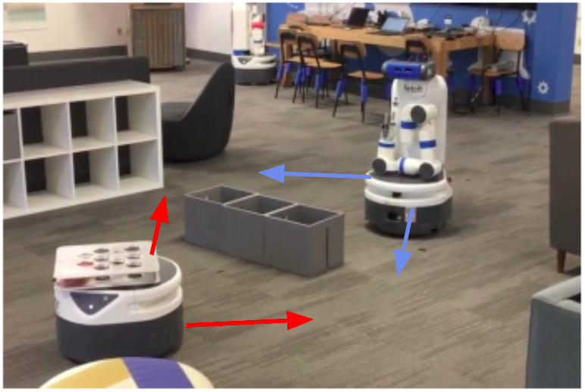
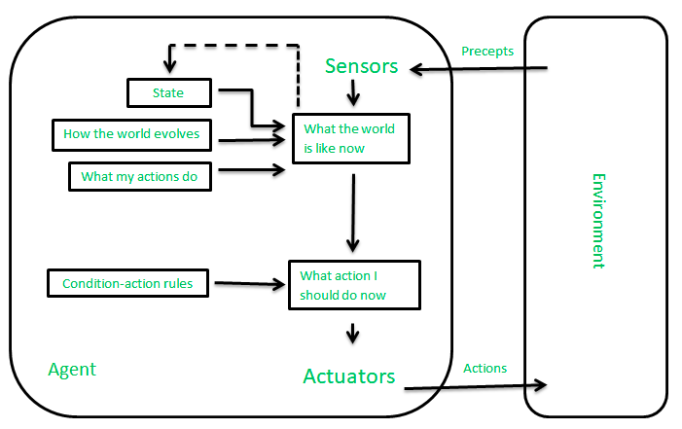
The Number and Types of Agents in Artificial Intelligence
There are five different types of intelligent agents used in AI. They are defined by their range of capabilities and intelligence level:
Model-based reflex agents
These agents choose their actions like reflex agents do, but they have a better comprehensive view of the environment.
It works by finding a rule whose condition matches the current situation.
An environmental model is programmed into the internal system, incorporating into the Agent's history
Model − knowledge about “how the things happen in the world”.
Link 2

Slide 8
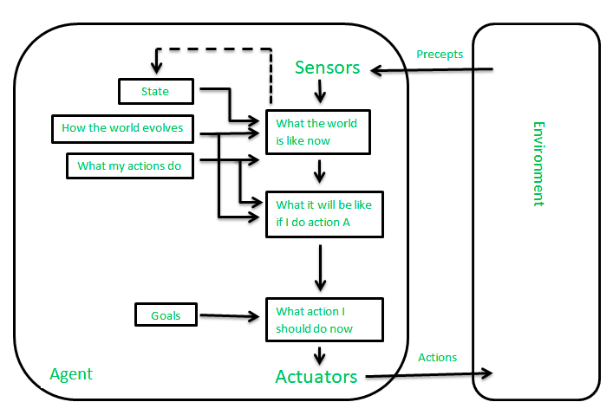
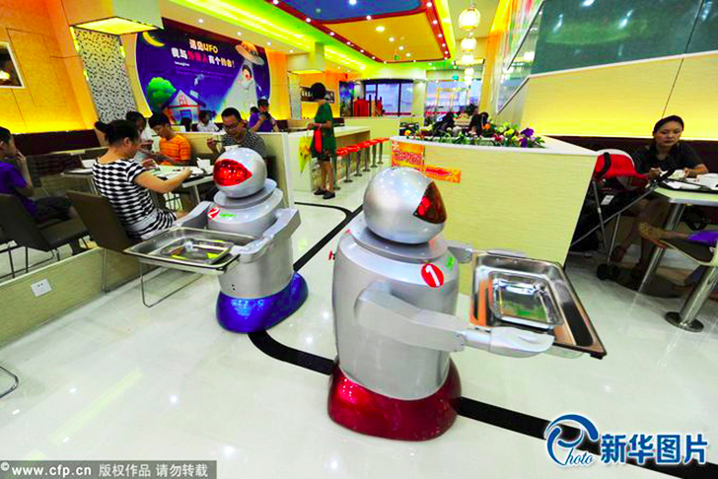
The Number and Types of Agents in Artificial Intelligence
There are five different types of intelligent agents used in AI. They are defined by their range of capabilities and intelligence level:
Goal Based Agents
These kinds of agents take decisions based on how far they are currently from their goal.
They choose their actions in order to achieve goals.
Their every action is intended to reduce its distance from the goal.
Model − knowledge about “how the things happen in the world”.
Link 2

Slide 9
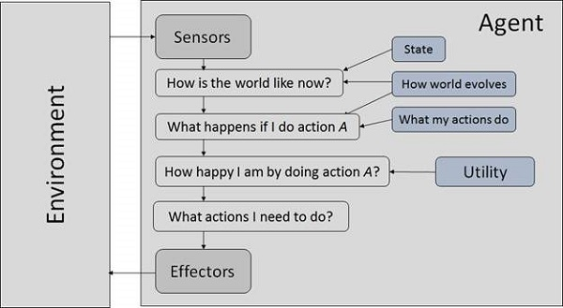
The Number and Types of Agents in Artificial Intelligence
There are five different types of intelligent agents used in AI. They are defined by their range of capabilities and intelligence level:
Utility-based agents
They choose actions based on a preference (utility) for each state.
Goals are inadequate when:
There are conflicting goals, out of which only few can be achieved.
Goals have some uncertainty of being achieved and you need to weigh likelihood of success against the importance of a goal.
Model − knowledge about “how the things happen in the world”.
Link 2

Slide 10
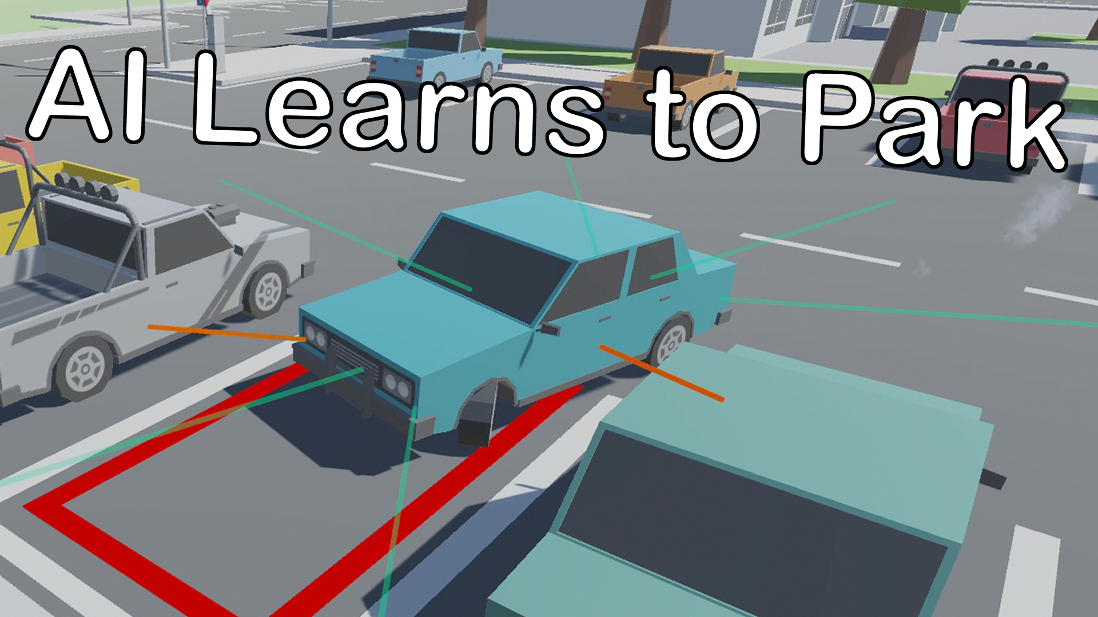
The Number and Types of Agents in Artificial Intelligence
There are five different types of intelligent agents used in AI. They are defined by their range of capabilities and intelligence level:
Learning agents:
A learning agent in AI is the type of agent that can learn from its past experiences or it has learning capabilities. It starts to act with basic knowledge and then is able to act and adapt automatically through learning.
These agents employ an additional learning element to gradually improve and become more knowledgeable over time about an environment.
Model − knowledge about “how the things happen in the world”.
Link 2

Slide 11
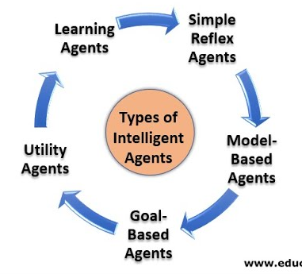
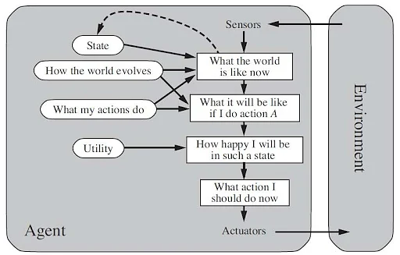
The Structure of Agents in Artificial Intelligence
Agents in Artificial Intelligence follow this simple structural formula:
Architecture + Agent Program = Agent
Architecture: This is the machinery or platform that executes the agent.
Agent Function: The agent function maps a precept to the Action, represented by the following formula: f:P* - A
Agent Program: The agent program is an implementation of the agent function. The agent program produces function f by executing on the physical architecture.
Rationality: Rationality is nothing but status of being reasonable, sensible, and having good sense of judgment.

Slide 12
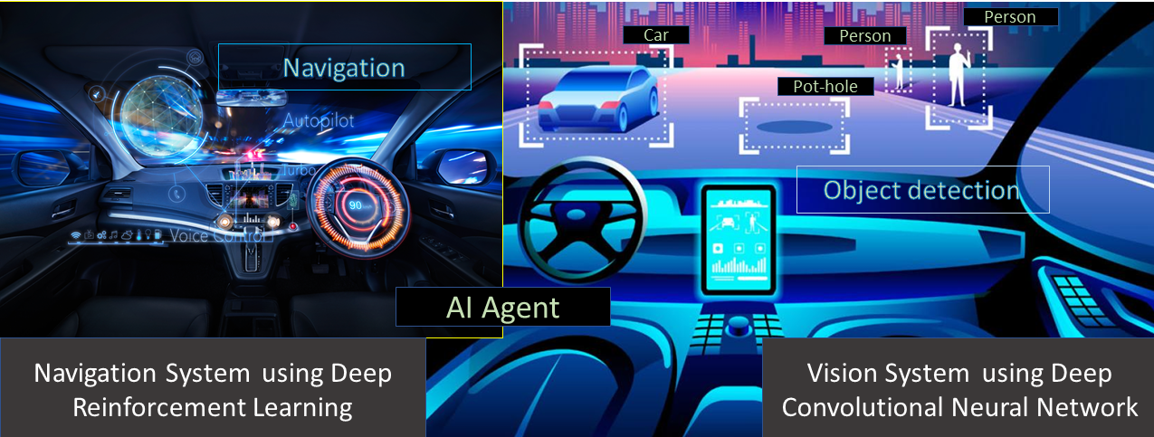
What Are Agents in Artificial Intelligence Composed Of?
Agents in Artificial Intelligence contain the following properties:
Environment
The agent is situated in a given environment.
Autonomous
The agent can operate without direct human intervention or other software methods.
Flexibility
Proactive: Agents shouldn’t only act in response to their surroundings but also be able to take the initiative when appropriate and effect an opportunistic, goal-directed performance.
Social: Agents should work with humans or other non-human agents.
Reactive
Reactive systems maintain ongoing interactions with their environment, responding to its changes.

Slide 13
Thanks
cesar.sinchiguano@uleam.edu.ec

